Slide 1
ECON1002 Intro. Macro.
Tutorial 7
Herbert Xin
wei.xin@sydney.edu.au

Slide 2
Plan of Today
Tutorial Questions
Only question 2?
Practice Questions
Midsemester Exam
April 11th 2024 at 18:00 online via Canvas
Content: Contents of Weeks 1 to 5, excluding chapter 9 of the textbook.
Duration and type: 80 minutes; MCQs, Numerical answers and Fill in the
blanks questions. 31 questions in total for 35 points.
The exam will not be available after 19:20.
You can use a calculator. Open book, but beware of time.

Slide 3
Tutorial Questions

Slide 4
Question 1
Real GDP is $8 trillion, nominal GDP is $10 trillion, M1 is $2 trillion, and M3 is $5 trillion.

Slide 5
Question 1
Real GDP is $8 trillion, nominal GDP is $10 trillion, M1 is $2 trillion, and M3 is $5 trillion.
a. Find velocity for M1 and for M3.

Slide 6
Question 1
Real GDP is $8 trillion, nominal GDP is $10 trillion, M1 is $2 trillion, and M3 is $5 trillion.
a. Find velocity for M1 and for M3.
M1 – Currency + Current bank deposits
M3 – M1 + Deposits of private non-banks

Slide 7
Question 1
Real GDP is $8 trillion, nominal GDP is $10 trillion, M1 is $2 trillion, and M3 is $5 trillion.
a. Find velocity for M1 and for M3.
M1 – Currency + Current bank deposits
M3 – M1 + Deposits of private non-banks
Quantity theory of money

Slide 8
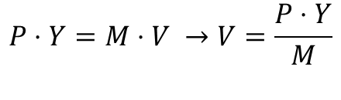
Question 1
Real GDP is $8 trillion, nominal GDP is $10 trillion, M1 is $2 trillion, and M3 is $5 trillion.
a. Find velocity for M1 and for M3.
M1 – Currency + Current bank deposits
M3 – M1 + Deposits of private non-banks
Quantity theory of money
$$P⋅Y=M⋅V →V=\frac{P⋅Y}{M}$$

Slide 9
Question 1
Real GDP is $8 trillion, nominal GDP is $10 trillion, M1 is $2 trillion, and M3 is $5 trillion.
a. Find velocity for M1 and for M3.
M1 – Currency + Current bank deposits
M3 – M1 + Deposits of private non-banks
Quantity theory of money
$$P⋅Y=M⋅V →V=\frac{P⋅Y}{M}$$
Velocity
Price level
Money Base
Real GDP

Slide 10


Question 1
Real GDP is $8 trillion, nominal GDP is $10 trillion, M1 is $2 trillion, and M3 is $5 trillion.
a. Find velocity for M1 and for M3.
M1 – Currency + Current bank deposits
M3 – M1 + Deposits of private non-banks
Quantity theory of money
$$P⋅Y=M⋅V →V=\frac{P⋅Y}{M}$$
Real GDP: $Y=8$
Nominal GDP: $P⋅Y=10$
Velocity
Price level
Money Base
Real GDP

Slide 11
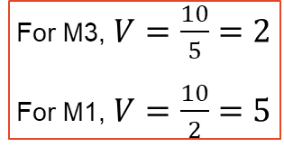
Question 1
Real GDP is $8 trillion, nominal GDP is $10 trillion, M1 is $2 trillion, and M3 is $5 trillion.
a. Find velocity for M1 and for M3.
M1 – Currency + Current bank deposits
M3 – M1 + Deposits of private non-banks
Quantity theory of money
$$P⋅Y=M⋅V →V=\frac{P⋅Y}{M}$$
Real GDP: $Y=8$
Nominal GDP: $P⋅Y=10$
Velocity
For M3, $V=\frac{10}{5}=2$
For M1, $V=\frac{10}{2}=5$
Price level
Money Base
Real GDP

Slide 12
Question 1
Real GDP is $8 trillion, nominal GDP is $10 trillion, M1 is $2 trillion, and M3 is $5 trillion.
b. Show that the quantity equation holds for both M1 and M3.

Slide 13

Question 1
Real GDP is $8 trillion, nominal GDP is $10 trillion, M1 is $2 trillion, and M3 is $5 trillion.
b. Show that the quantity equation holds for both M1 and M3.
What a question! Basically asking you show the reverse works, i.e.
$$V⋅M=P⋅Y$$

Slide 14
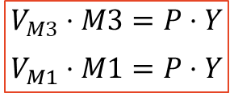
Question 1
Real GDP is $8 trillion, nominal GDP is $10 trillion, M1 is $2 trillion, and M3 is $5 trillion.
b. Show that the quantity equation holds for both M1 and M3.
What a question! Basically asking you show the reverse works, i.e.
$$V_{M3}⋅M3=P⋅Y$$
$$V_{M1}⋅M1=P⋅Y$$
$$V⋅M=P⋅Y$$

Slide 15




Question 2
An economy is described by the following equations.
a. Find a numerical equation relating planned aggregate expenditure to output. Solve for short run equilibrium output. Show your results graphically using the Keynesian cross diagram.
$$C=2600+0.8\left(Y−T\right)−10,000r$$
$$I^{P}=2000−10,000r$$
$$G=1800$$
$$NX=0$$
$$T=3000$$
The real interest rate, expressed as a decimal, is 0.10 (that is, 10 percent)

Slide 16

Question 2
An economy is described by the following equations.
a. Find a numerical equation relating planned aggregate expenditure to output. Solve for short run equilibrium output. Show your results graphically using the Keynesian cross diagram.
$$C=2600+0.8\left(Y−T\right)−10,000r$$
$$Y=PAE=C+I^{P}+G+NX$$
$$I^{P}=2000−10,000r$$
$$G=1800$$
$$NX=0$$
$$T=3000$$
The real interest rate, expressed as a decimal, is 0.10 (that is, 10 percent)

Slide 17

Question 2
An economy is described by the following equations.
a. Find a numerical equation relating planned aggregate expenditure to output. Solve for short run equilibrium output. Show your results graphically using the Keynesian cross diagram.
$$C=2600+0.8\left(Y−T\right)−10,000r$$
$$Y=PAE=C+I^{P}+G+NX$$
$$I^{P}=2000−10,000r$$
$$Y=2600+0.8\left(Y−3000\right)−10,000r$$
$$+2000−10,000r+1800$$
$$G=1800$$
$$NX=0$$
$$T=3000$$
The real interest rate, expressed as a decimal, is 0.10 (that is, 10 percent)

Slide 18
Question 2
An economy is described by the following equations.
a. Find a numerical equation relating planned aggregate expenditure to output. Solve for short run equilibrium output. Show your results graphically using the Keynesian cross diagram.
$$C=2600+0.8\left(Y−T\right)−10,000r$$
$$Y=PAE=C+I^{P}+G+NX$$
$$I^{P}=2000−10,000r$$
$$Y=2600+0.8\left(Y−3000\right)−10,000r$$
$$+2000−10,000r+1800$$
$$G=1800$$
$$NX=0$$
$$Y=6400+0.8\left(Y−3000\right)−20,000r$$
$$T=3000$$
The real interest rate, expressed as a decimal, is 0.10 (that is, 10 percent)

Slide 19

Question 2
An economy is described by the following equations.
a. Find a numerical equation relating planned aggregate expenditure to output. Solve for short run equilibrium output. Show your results graphically using the Keynesian cross diagram.
$$C=2600+0.8\left(Y−T\right)−10,000r$$
$$Y=PAE=C+I^{P}+G+NX$$
$$I^{P}=2000−10,000r$$
$$Y=2600+0.8\left(Y−3000\right)−10,000r$$
$$+2000−10,000r+1800$$
$$G=1800$$
$$NX=0$$
$$Y=6400+0.8\left(Y−3000\right)−20,000r$$
$$T=3000$$
$$Y=4000+0.8Y−20,000r$$
The real interest rate, expressed as a decimal, is 0.10 (that is, 10 percent)

Slide 20

Question 2
An economy is described by the following equations.
a. Find a numerical equation relating planned aggregate expenditure to output. Solve for short run equilibrium output. Show your results graphically using the Keynesian cross diagram.
$$C=2600+0.8\left(Y−T\right)−10,000r$$
$$Y=PAE=C+I^{P}+G+NX$$
$$I^{P}=2000−10,000r$$
$$Y=2600+0.8\left(Y−3000\right)−10,000r$$
$$+2000−10,000r+1800$$
$$G=1800$$
$$NX=0$$
$$Y=6400+0.8\left(Y−3000\right)−20,000r$$
$$T=3000$$
$$Y=4000+0.8Y−20,000r$$
The real interest rate, expressed as a decimal, is 0.10 (that is, 10 percent)
$$0.2Y=4000−20,000r$$

Slide 21

Question 2
An economy is described by the following equations.
a. Find a numerical equation relating planned aggregate expenditure to output. Solve for short run equilibrium output. Show your results graphically using the Keynesian cross diagram.
$$C=2600+0.8\left(Y−T\right)−10,000r$$
$$Y=PAE=C+I^{P}+G+NX$$
$$I^{P}=2000−10,000r$$
$$Y=2600+0.8\left(Y−3000\right)−10,000r$$
$$+2000−10,000r+1800$$
$$G=1800$$
$$NX=0$$
$$Y=6400+0.8\left(Y−3000\right)−20,000r$$
$$T=3000$$
$$Y=4000+0.8Y−20,000r$$
The real interest rate, expressed as a decimal, is 0.10 (that is, 10 percent)
$$0.2Y=4000−20,000r$$
$$Y=\frac{1}{0.2}(4000−20,000r)$$

Slide 22
Question 2
An economy is described by the following equations.
a. Find a numerical equation relating planned aggregate expenditure to output. Solve for short run equilibrium output. Show your results graphically using the Keynesian cross diagram.
$$C=2600+0.8\left(Y−T\right)−10,000r$$
$$Y=PAE=C+I^{P}+G+NX$$
$$I^{P}=2000−10,000r$$
$$Y=2600+0.8\left(Y−3000\right)−10,000r$$
$$+2000−10,000r+1800$$
$$G=1800$$
$$NX=0$$
$$Y=6400+0.8\left(Y−3000\right)−20,000r$$
$$T=3000$$
$$Y=4000+0.8Y−20,000r$$
The real interest rate, expressed as a decimal, is 0.10 (that is, 10 percent)
$$0.2Y=4000−20,000r$$
$$Y=\frac{1}{0.2}(4000−20,000r)$$

Slide 23
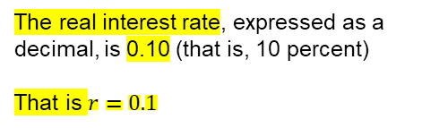
Question 2
An economy is described by the following equations.
a. Find a numerical equation relating planned aggregate expenditure to output. Solve for short run equilibrium output. Show your results graphically using the Keynesian cross diagram.
$$C=2600+0.8\left(Y−T\right)−10,000r$$
$$Y=PAE=C+I^{P}+G+NX$$
$$I^{P}=2000−10,000r$$
$$Y=2600+0.8\left(Y−3000\right)−10,000r$$
$$+2000−10,000r+1800$$
$$G=1800$$
$$NX=0$$
$$Y=6400+0.8\left(Y−3000\right)−20,000r$$
$$T=3000$$
$$Y=4000+0.8Y−20,000r$$
The real interest rate, expressed as a decimal, is 0.10 (that is, 10 percent)
That is $r=0.1$
$$0.2Y=4000−20,000r$$
$$Y=\frac{1}{0.2}(4000−20,000r)$$

Slide 24

Question 2
An economy is described by the following equations.
a. Find a numerical equation relating planned aggregate expenditure to output. Solve for short run equilibrium output. Show your results graphically using the Keynesian cross diagram.
$$C=2600+0.8\left(Y−T\right)−10,000r$$
$$Y=PAE=C+I^{P}+G+NX$$
$$I^{P}=2000−10,000r$$
$$Y=2600+0.8\left(Y−3000\right)−10,000r$$
$$+2000−10,000r+1800$$
$$G=1800$$
$$NX=0$$
$$Y=6400+0.8\left(Y−3000\right)−20,000r$$
$$T=3000$$
$$Y=4000+0.8Y−20,000r$$
The real interest rate, expressed as a decimal, is 0.10 (that is, 10 percent)
That is $r=0.1$
$$0.2Y=4000−20,000r$$
$$Y=\frac{1}{0.2}(4000−20,000r)$$
$$Y=\frac{1}{0.2}\left(4000−20,000⋅0.1\right)=10,000$$

Slide 25
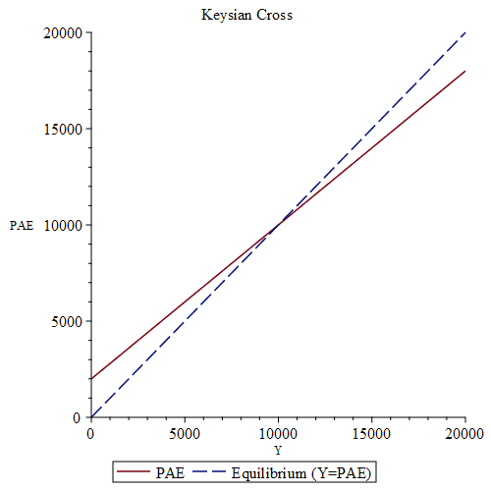
Question 2
An economy is described by the following equations.
a. Find a numerical equation relating planned aggregate expenditure to output. Solve for short run equilibrium output. Show your results graphically using the Keynesian cross diagram.
$$C=2600+0.8\left(Y−T\right)−10,000r$$
$$I^{P}=2000−10,000r$$
$$G=1800$$
$$NX=0$$
$$T=3000$$
The real interest rate, expressed as a decimal, is 0.10 (that is, 10 percent)
That is $r=0.1$

Slide 26
Question 2
An economy is described by the following equations.
b. Potential output Y* equals 12,000. What real interest rate should the Reserve Bank set to bring the economy to full employment? You may take as given that the multiplier for this economy is 5.
$$C=2600+0.8\left(Y−T\right)−10,000r$$
$$I^{P}=2000−10,000r$$
$$G=1800$$
$$NX=0$$
$$T=3000$$
The real interest rate, expressed as a decimal, is 0.10 (that is, 10 percent)

Slide 27
Question 2
An economy is described by the following equations.
b. Potential output Y* equals 12,000. What real interest rate should the Reserve Bank set to bring the economy to full employment? You may take as given that the multiplier for this economy is 5.
$$C=2600+0.8\left(Y−T\right)−10,000r$$
$ΔY=$ Multiplier$⋅$ Coef Exo-var$⋅Δ$(Exo-var)
$$I^{P}=2000−10,000r$$
$$G=1800$$
$$NX=0$$
$$T=3000$$
The real interest rate, expressed as a decimal, is 0.10 (that is, 10 percent)

Slide 28


Question 2
An economy is described by the following equations.
b. Potential output Y* equals 12,000. What real interest rate should the Reserve Bank set to bring the economy to full employment? You may take as given that the multiplier for this economy is 5.
$$C=2600+0.8\left(Y−T\right)−10,000r$$
$ΔY=$ Multiplier$⋅$ Coef Exo-var$⋅Δ$(Exo-var)
$$I^{P}=2000−10,000r$$
$ΔY=$ Multiplier$⋅−20,000⋅Δr$
$$G=1800$$
$$NX=0$$
$$T=3000$$
The real interest rate, expressed as a decimal, is 0.10 (that is, 10 percent)

Slide 29

Question 2
An economy is described by the following equations.
b. Potential output Y* equals 12,000. What real interest rate should the Reserve Bank set to bring the economy to full employment? You may take as given that the multiplier for this economy is 5.
$$C=2600+0.8\left(Y−T\right)−10,000r$$
$ΔY=$ Multiplier$⋅$ Coef Exo-var$⋅Δ$(Exo-var)
$$I^{P}=2000−10,000r$$
$ΔY=$ Multiplier$⋅−20,000⋅Δr$
$$G=1800$$
$$Y=10,000, Y^{∗}=12,000 →ΔY=2,000$$
$$NX=0$$
$$T=3000$$
The real interest rate, expressed as a decimal, is 0.10 (that is, 10 percent)

Slide 30

Question 2
An economy is described by the following equations.
b. Potential output Y* equals 12,000. What real interest rate should the Reserve Bank set to bring the economy to full employment? You may take as given that the multiplier for this economy is 5.
$$C=2600+0.8\left(Y−T\right)−10,000r$$
$ΔY=$ Multiplier$⋅$ Coef Exo-var$⋅Δ$(Exo-var)
$$I^{P}=2000−10,000r$$
$ΔY=$ Multiplier$⋅−20,000⋅Δr$
$$G=1800$$
$$Y=10,000, Y^{∗}=12,000 →ΔY=2,000$$
$$NX=0$$
$$2,000=5⋅−20,000⋅Δr$$
$$T=3000$$
The real interest rate, expressed as a decimal, is 0.10 (that is, 10 percent)

Slide 31

Question 2
An economy is described by the following equations.
b. Potential output Y* equals 12,000. What real interest rate should the Reserve Bank set to bring the economy to full employment? You may take as given that the multiplier for this economy is 5.
$$C=2600+0.8\left(Y−T\right)−10,000r$$
$ΔY=$ Multiplier$⋅$ Coef Exo-var$⋅Δ$(Exo-var)
$$I^{P}=2000−10,000r$$
$ΔY=$ Multiplier$⋅−20,000⋅Δr$
$$G=1800$$
$$Y=10,000, Y^{∗}=12,000 →ΔY=2,000$$
$$NX=0$$
$$2,000=5⋅−20,000⋅Δr$$
$$T=3000$$
$$Δr=−0.02$$
The real interest rate, expressed as a decimal, is 0.10 (that is, 10 percent)

Slide 32

Question 2
An economy is described by the following equations.
b. Potential output Y* equals 12,000. What real interest rate should the Reserve Bank set to bring the economy to full employment? You may take as given that the multiplier for this economy is 5.
$$C=2600+0.8\left(Y−T\right)−10,000r$$
$ΔY=$ Multiplier$⋅$ Coef Exo-var$⋅Δ$(Exo-var)
$$I^{P}=2000−10,000r$$
$ΔY=$ Multiplier$⋅−20,000⋅Δr$
$$G=1800$$
$$Y=10,000, Y^{∗}=12,000 →ΔY=2,000$$
$$NX=0$$
$$2,000=5⋅−20,000⋅Δr$$
$$T=3000$$
$$Δr=−0.02$$
The real interest rate, expressed as a decimal, is 0.10 (that is, 10 percent)
$$r=0.08$$

Slide 33
Question 2
An economy is described by the following equations.
c. Repeat part (b) for the case in which potential output Y* = 9,000.
$$C=2600+0.8\left(Y−T\right)−10,000r$$
$$I^{P}=2000−10,000r$$
$$G=1800$$
$$NX=0$$
$$T=3000$$
The real interest rate, expressed as a decimal, is 0.10 (that is, 10 percent)

Slide 34

Question 2
An economy is described by the following equations.
c. Repeat part (b) for the case in which potential output Y* = 9,000.
$ΔY=$ Multiplier $⋅$ Coef Exo-var$⋅Δ$(Exo-var)
$$C=2600+0.8\left(Y−T\right)−10,000r$$
$ΔY=$ Multiplier$⋅−20,000⋅Δr$
$$I^{P}=2000−10,000r$$
$$G=1800$$
$$NX=0$$
$$T=3000$$
The real interest rate, expressed as a decimal, is 0.10 (that is, 10 percent)

Slide 35
Question 2
An economy is described by the following equations.
c. Repeat part (b) for the case in which potential output Y* = 9,000.
$ΔY=$ Multiplier $⋅$ Coef Exo-var$⋅Δ$(Exo-var)
$$C=2600+0.8\left(Y−T\right)−10,000r$$
$ΔY=$ Multiplier$⋅−20,000⋅Δr$
$$I^{P}=2000−10,000r$$
$$Y=10,000, Y^{∗}=9,000 →ΔY=−1,000$$
$$G=1800$$
$$NX=0$$
$$T=3000$$
The real interest rate, expressed as a decimal, is 0.10 (that is, 10 percent)

Slide 36

Question 2
An economy is described by the following equations.
c. Repeat part (b) for the case in which potential output Y* = 9,000.
$ΔY=$ Multiplier $⋅$ Coef Exo-var$⋅Δ$(Exo-var)
$$C=2600+0.8\left(Y−T\right)−10,000r$$
$ΔY=$ Multiplier$⋅−20,000⋅Δr$
$$I^{P}=2000−10,000r$$
$$Y=10,000, Y^{∗}=9,000 →ΔY=−1,000$$
$$G=1800$$
$$−1,000=5⋅−20,000⋅Δr$$
$$NX=0$$
$$T=3000$$
The real interest rate, expressed as a decimal, is 0.10 (that is, 10 percent)

Slide 37

Question 2
An economy is described by the following equations.
c. Repeat part (b) for the case in which potential output Y* = 9,000.
$ΔY=$ Multiplier $⋅$ Coef Exo-var$⋅Δ$(Exo-var)
$$C=2600+0.8\left(Y−T\right)−10,000r$$
$ΔY=$ Multiplier$⋅−20,000⋅Δr$
$$I^{P}=2000−10,000r$$
$$Y=10,000, Y^{∗}=9,000 →ΔY=−1,000$$
$$G=1800$$
$$−1,000=5⋅−20,000⋅Δr$$
$$NX=0$$
$$Δr=0.01$$
$$T=3000$$
The real interest rate, expressed as a decimal, is 0.10 (that is, 10 percent)

Slide 38

Question 2
An economy is described by the following equations.
c. Repeat part (b) for the case in which potential output Y* = 9,000.
$ΔY=$ Multiplier $⋅$ Coef Exo-var$⋅Δ$(Exo-var)
$$C=2600+0.8\left(Y−T\right)−10,000r$$
$ΔY=$ Multiplier$⋅−20,000⋅Δr$
$$I^{P}=2000−10,000r$$
$$Y=10,000, Y^{∗}=9,000 →ΔY=−1,000$$
$$G=1800$$
$$−1,000=5⋅−20,000⋅Δr$$
$$NX=0$$
$$Δr=0.01$$
$$T=3000$$
$$r=0.11$$
The real interest rate, expressed as a decimal, is 0.10 (that is, 10 percent)

Slide 39
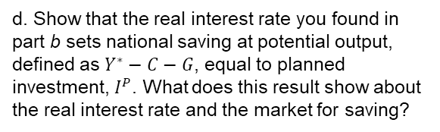
Question 2
An economy is described by the following equations.
d. Show that the real interest rate you found in part b sets national saving at potential output, defined as $Y^{∗}−C−G$, equal to planned investment, $I^{P}$. What does this result show about the real interest rate and the market for saving?
$$C=2600+0.8\left(Y−T\right)−10,000r$$
$$I^{P}=2000−10,000r$$
$$G=1800$$
$$NX=0$$
$$T=3000$$
The real interest rate, expressed as a decimal, is 0.10 (that is, 10 percent)

Slide 40

Question 2
An economy is described by the following equations.
d. Show that the real interest rate you found in part b sets national saving at potential output, defined as $Y^{∗}−C−G$, equal to planned investment, $I^{P}$. What does this result show about the real interest rate and the market for saving?
$$C=2600+0.8\left(Y−T\right)−10,000r$$
$$I^{P}=2000−10,000r$$
$$NS=Y^{∗}−C−G$$
$$G=1800$$
$$NX=0$$
$$T=3000$$
The real interest rate, expressed as a decimal, is 0.10 (that is, 10 percent)

Slide 41
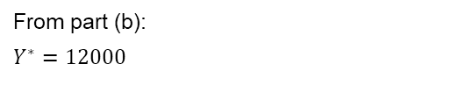
Question 2
An economy is described by the following equations.
d. Show that the real interest rate you found in part b sets national saving at potential output, defined as $Y^{∗}−C−G$, equal to planned investment, $I^{P}$. What does this result show about the real interest rate and the market for saving?
$$C=2600+0.8\left(Y−T\right)−10,000r$$
$$I^{P}=2000−10,000r$$
$$NS=Y^{∗}−C−G$$
$$G=1800$$
From part (b):
$$Y^{∗}=12000$$
$$NX=0$$
$$T=3000$$
The real interest rate, expressed as a decimal, is 0.10 (that is, 10 percent)

Slide 42
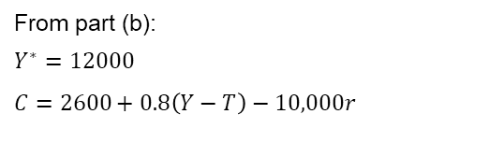
Question 2
An economy is described by the following equations.
d. Show that the real interest rate you found in part b sets national saving at potential output, defined as $Y^{∗}−C−G$, equal to planned investment, $I^{P}$. What does this result show about the real interest rate and the market for saving?
$$C=2600+0.8\left(Y−T\right)−10,000r$$
$$I^{P}=2000−10,000r$$
$$NS=Y^{∗}−C−G$$
$$G=1800$$
From part (b):
$$Y^{∗}=12000$$
$$C=2600+0.8\left(Y−T\right)−10,000r$$
$$NX=0$$
$$T=3000$$
The real interest rate, expressed as a decimal, is 0.10 (that is, 10 percent)

Slide 43
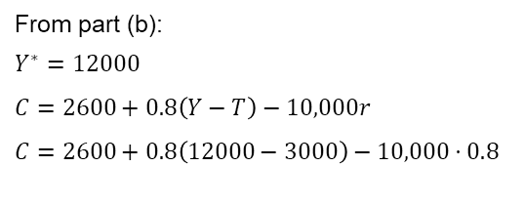
Question 2
An economy is described by the following equations.
d. Show that the real interest rate you found in part b sets national saving at potential output, defined as $Y^{∗}−C−G$, equal to planned investment, $I^{P}$. What does this result show about the real interest rate and the market for saving?
$$C=2600+0.8\left(Y−T\right)−10,000r$$
$$I^{P}=2000−10,000r$$
$$NS=Y^{∗}−C−G$$
$$G=1800$$
From part (b):
$$Y^{∗}=12000$$
$$C=2600+0.8\left(Y−T\right)−10,000r$$
$$C=2600+0.8\left(12000−3000\right)−10,000⋅0.8$$
$$NX=0$$
$$T=3000$$
The real interest rate, expressed as a decimal, is 0.10 (that is, 10 percent)

Slide 44
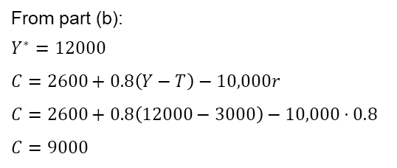
Question 2
An economy is described by the following equations.
d. Show that the real interest rate you found in part b sets national saving at potential output, defined as $Y^{∗}−C−G$, equal to planned investment, $I^{P}$. What does this result show about the real interest rate and the market for saving?
$$C=2600+0.8\left(Y−T\right)−10,000r$$
$$I^{P}=2000−10,000r$$
$$NS=Y^{∗}−C−G$$
$$G=1800$$
From part (b):
$$Y^{∗}=12000$$
$$C=2600+0.8\left(Y−T\right)−10,000r$$
$$C=2600+0.8\left(12000−3000\right)−10,000⋅0.8$$
$$C=9000$$
$$NX=0$$
$$T=3000$$
The real interest rate, expressed as a decimal, is 0.10 (that is, 10 percent)

Slide 45
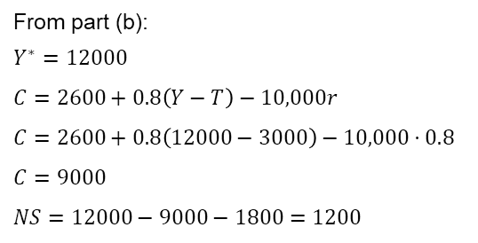
Question 2
An economy is described by the following equations.
d. Show that the real interest rate you found in part b sets national saving at potential output, defined as $Y^{∗}−C−G$, equal to planned investment, $I^{P}$. What does this result show about the real interest rate and the market for saving?
$$C=2600+0.8\left(Y−T\right)−10,000r$$
$$I^{P}=2000−10,000r$$
$$NS=Y^{∗}−C−G$$
$$G=1800$$
From part (b):
$$Y^{∗}=12000$$
$$C=2600+0.8\left(Y−T\right)−10,000r$$
$$C=2600+0.8\left(12000−3000\right)−10,000⋅0.8$$
$$C=9000$$
$$NS=12000−9000−1800=1200$$
$$NX=0$$
$$T=3000$$
The real interest rate, expressed as a decimal, is 0.10 (that is, 10 percent)

Slide 46
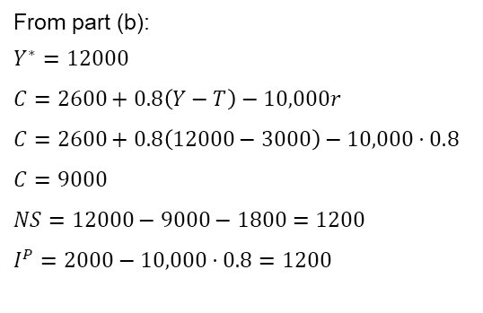
Question 2
An economy is described by the following equations.
d. Show that the real interest rate you found in part b sets national saving at potential output, defined as $Y^{∗}−C−G$, equal to planned investment, $I^{P}$. What does this result show about the real interest rate and the market for saving?
$$C=2600+0.8\left(Y−T\right)−10,000r$$
$$I^{P}=2000−10,000r$$
$$NS=Y^{∗}−C−G$$
$$G=1800$$
From part (b):
$$Y^{∗}=12000$$
$$C=2600+0.8\left(Y−T\right)−10,000r$$
$$C=2600+0.8\left(12000−3000\right)−10,000⋅0.8$$
$$C=9000$$
$$NS=12000−9000−1800=1200$$
$$I^{P}=2000−10,000⋅0.8=1200$$
$$NX=0$$
$$T=3000$$
The real interest rate, expressed as a decimal, is 0.10 (that is, 10 percent)

Slide 47
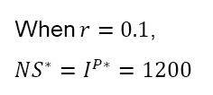
Question 2
An economy is described by the following equations.
d. Show that the real interest rate you found in part b sets national saving at potential output, defined as $Y^{∗}−C−G$, equal to planned investment, $I^{P}$. What does this result show about the real interest rate and the market for saving?
$$C=2600+0.8\left(Y−T\right)−10,000r$$
$$I^{P}=2000−10,000r$$
When $r=0.1$,
$$NS^{∗}=I^{P∗}=1200$$
$$G=1800$$
$$NX=0$$
$$T=3000$$
The real interest rate, expressed as a decimal, is 0.10 (that is, 10 percent)

Slide 48
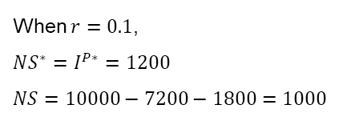
Question 2
An economy is described by the following equations.
d. Show that the real interest rate you found in part b sets national saving at potential output, defined as $Y^{∗}−C−G$, equal to planned investment, $I^{P}$. What does this result show about the real interest rate and the market for saving?
$$C=2600+0.8\left(Y−T\right)−10,000r$$
$$I^{P}=2000−10,000r$$
When $r=0.1$,
$$NS^{∗}=I^{P∗}=1200$$
$$NS=10000−7200−1800=1000$$
$$G=1800$$
$$NX=0$$
$$T=3000$$
The real interest rate, expressed as a decimal, is 0.10 (that is, 10 percent)

Slide 49
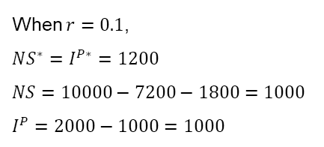
Question 2
An economy is described by the following equations.
d. Show that the real interest rate you found in part b sets national saving at potential output, defined as $Y^{∗}−C−G$, equal to planned investment, $I^{P}$. What does this result show about the real interest rate and the market for saving?
$$C=2600+0.8\left(Y−T\right)−10,000r$$
$$I^{P}=2000−10,000r$$
When $r=0.1$,
$$NS^{∗}=I^{P∗}=1200$$
$$NS=10000−7200−1800=1000$$
$$I^{P}=2000−1000=1000$$
$$G=1800$$
$$NX=0$$
$$T=3000$$
The real interest rate, expressed as a decimal, is 0.10 (that is, 10 percent)

Slide 50
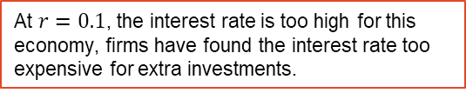
Question 2
An economy is described by the following equations.
d. Show that the real interest rate you found in part b sets national saving at potential output, defined as $Y^{∗}−C−G$, equal to planned investment, $I^{P}$. What does this result show about the real interest rate and the market for saving?
$$C=2600+0.8\left(Y−T\right)−10,000r$$
$$I^{P}=2000−10,000r$$
When $r=0.1$,
$$NS^{∗}=I^{P∗}=1200$$
$$NS=10000−7200−1800=1000$$
$$I^{P}=2000−1000=1000$$
$$G=1800$$
$$NX=0$$
$$T=3000$$
The real interest rate, expressed as a decimal, is 0.10 (that is, 10 percent)
At $r=0.1$, the interest rate is too high for this economy, firms have found the interest rate too expensive for extra investments.

Slide 51
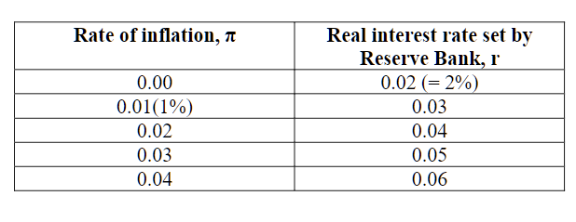

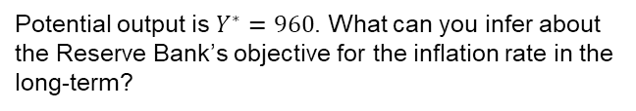
Question 3
Suppose the Reserve Bank follows the following policy reaction function.
For this economy, the relationship between short-run equilibrium output Y and the real interest rate r set by the Reserve Bank is given by
$$Y=1000−1000r$$
Potential output is $Y^{∗}=960$. What can you infer about the Reserve Bank’s objective for the inflation rate in the long-term?

Slide 52
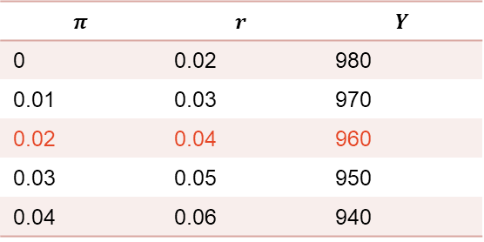
Question 3
Suppose the Reserve Bank follows the following policy reaction function.
$$π$$ | $$r$$ | $$Y$$
0 | 0.02 | 980
0.01 | 0.03 | 970
0.02 | 0.04 | 960
0.03 | 0.05 | 950
0.04 | 0.06 | 940
For this economy, the relationship between short-run equilibrium output Y and the real interest rate r set by the Reserve Bank is given by
$$Y=1000−1000r$$
Potential output is $Y^{∗}=960$. What can you infer about the Reserve Bank’s objective for the inflation rate in the long-term?

Slide 53
Question 3
Suppose the Reserve Bank follows the following policy reaction function.
$$π$$ | $$r$$ | $$Y$$
0 | 0.02 | 980
0.01 | 0.03 | 970
0.02 | 0.04 | 960
0.03 | 0.05 | 950
0.04 | 0.06 | 940
For this economy, the relationship between short-run equilibrium output Y and the real interest rate r set by the Reserve Bank is given by
When the inflation is high, RBA tries to increase policy rate to cool down the economy. When inflation is low, RBA lowers the rate to boost the economy, i.e. RBA is trying to do what we called “inflation targeting.”
$$Y=1000−1000r$$
Potential output is $Y^{∗}=960$. What can you infer about the Reserve Bank’s objective for the inflation rate in the long-term?

Slide 54






Question 4
An economy is described by the following equations.
a. Find a numerical equation relating planned aggregate expenditure to output and to the real
interest rate
$$C=14,400+0.5\left(Y−T\right)−40,000r$$
$$I^{P}=8, 000−20,000r$$
$$G=7,000$$
$$X=0$$
$$M=1,800$$
$$T=8,000$$
$$Y^{∗}=40,000$$

Slide 55
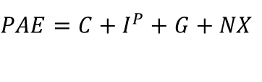
Question 4
An economy is described by the following equations.
a. Find a numerical equation relating planned aggregate expenditure to output and to the real
interest rate
$$C=14,400+0.5\left(Y−T\right)−40,000r$$
$$PAE=C+I^{P}+G+NX$$
$$I^{P}=8, 000−20,000r$$
$$G=7,000$$
$$X=0$$
$$M=1,800$$
$$T=8,000$$
$$Y^{∗}=40,000$$

Slide 56
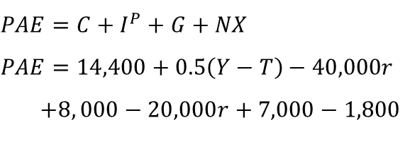
Question 4
An economy is described by the following equations.
a. Find a numerical equation relating planned aggregate expenditure to output and to the real
interest rate
$$C=14,400+0.5\left(Y−T\right)−40,000r$$
$$PAE=C+I^{P}+G+NX$$
$$PAE=14,400+0.5\left(Y−T\right)−40,000r$$
$+8, 000−20,000r+7,000−1,800$
$$I^{P}=8, 000−20,000r$$
$$G=7,000$$
$$X=0$$
$$M=1,800$$
$$T=8,000$$
$$Y^{∗}=40,000$$

Slide 57
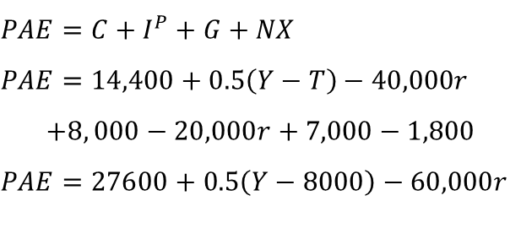
Question 4
An economy is described by the following equations.
a. Find a numerical equation relating planned aggregate expenditure to output and to the real
interest rate
$$C=14,400+0.5\left(Y−T\right)−40,000r$$
$$PAE=C+I^{P}+G+NX$$
$$PAE=14,400+0.5\left(Y−T\right)−40,000r$$
$$+8, 000−20,000r+7,000−1,800$$
$$PAE=27600+0.5\left(Y−8000\right)−60,000r$$
$$I^{P}=8, 000−20,000r$$
$$G=7,000$$
$$X=0$$
$$M=1,800$$
$$T=8,000$$
$$Y^{∗}=40,000$$

Slide 58
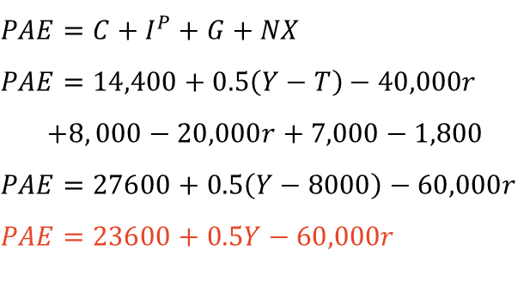
Question 4
An economy is described by the following equations.
a. Find a numerical equation relating planned aggregate expenditure to output and to the real
interest rate
$$C=14,400+0.5\left(Y−T\right)−40,000r$$
$$PAE=C+I^{P}+G+NX$$
$$PAE=14,400+0.5\left(Y−T\right)−40,000r$$
$$+8, 000−20,000r+7,000−1,800$$
$$PAE=27600+0.5\left(Y−8000\right)−60,000r$$
$$PAE=23600+0.5Y−60,000r$$
$$I^{P}=8, 000−20,000r$$
$$G=7,000$$
$$X=0$$
$$M=1,800$$
$$T=8,000$$
$$Y^{∗}=40,000$$

Slide 59
Question 4
An economy is described by the following equations.
b. At what value should the Reserve Bank set the real interest rate to eliminate the output
gap?
$$C=14,400+0.5\left(Y−T\right)−40,000r$$
$$I^{P}=8, 000−20,000r$$
$$G=7,000$$
$$X=0$$
$$M=1,800$$
$$T=8,000$$
$$Y^{∗}=40,000$$

Slide 60

Question 4
An economy is described by the following equations.
b. At what value should the Reserve Bank set the real interest rate to eliminate the output
gap?
$$PAE=23,600+0.5Y−60,000r$$
$$C=14,400+0.5\left(Y−T\right)−40,000r$$
$$I^{P}=8, 000−20,000r$$
$$G=7,000$$
$$X=0$$
$$M=1,800$$
$$T=8,000$$
$$Y^{∗}=40,000$$

Slide 61
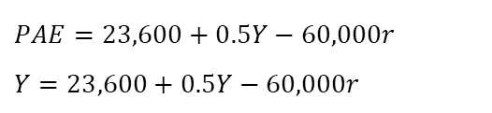
Question 4
An economy is described by the following equations.
b. At what value should the Reserve Bank set the real interest rate to eliminate the output
gap?
$$PAE=23,600+0.5Y−60,000r$$
$$Y=23,600+0.5Y−60,000r$$
$$C=14,400+0.5\left(Y−T\right)−40,000r$$
$$I^{P}=8, 000−20,000r$$
$$G=7,000$$
$$X=0$$
$$M=1,800$$
$$T=8,000$$
$$Y^{∗}=40,000$$

Slide 62
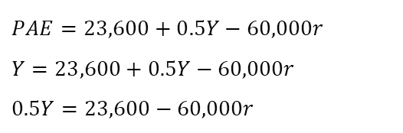
Question 4
An economy is described by the following equations.
b. At what value should the Reserve Bank set the real interest rate to eliminate the output
gap?
$$PAE=23,600+0.5Y−60,000r$$
$$Y=23,600+0.5Y−60,000r$$
$$0.5Y=23,600−60,000r$$
$$C=14,400+0.5\left(Y−T\right)−40,000r$$
$$I^{P}=8, 000−20,000r$$
$$G=7,000$$
$$X=0$$
$$M=1,800$$
$$T=8,000$$
$$Y^{∗}=40,000$$

Slide 63
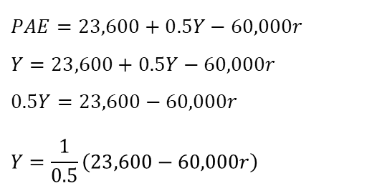
Question 4
An economy is described by the following equations.
b. At what value should the Reserve Bank set the real interest rate to eliminate the output
gap?
$$PAE=23,600+0.5Y−60,000r$$
$$Y=23,600+0.5Y−60,000r$$
$$0.5Y=23,600−60,000r$$
$$Y=\frac{1}{0.5}\left(23,600−60,000r\right)$$
$$C=14,400+0.5\left(Y−T\right)−40,000r$$
$$I^{P}=8, 000−20,000r$$
$$G=7,000$$
$$X=0$$
$$M=1,800$$
$$T=8,000$$
$$Y^{∗}=40,000$$

Slide 64
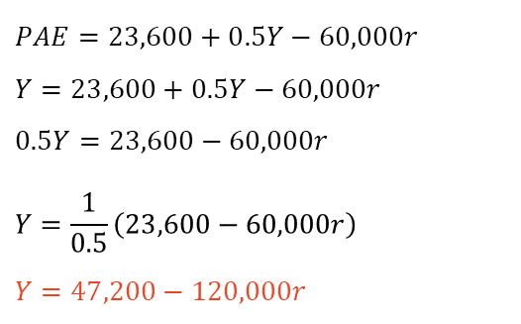
Question 4
An economy is described by the following equations.
b. At what value should the Reserve Bank set the real interest rate to eliminate the output
gap?
$$PAE=23,600+0.5Y−60,000r$$
$$Y=23,600+0.5Y−60,000r$$
$$0.5Y=23,600−60,000r$$
$$Y=\frac{1}{0.5}\left(23,600−60,000r\right)$$
$$Y=47,200−120,000r$$
$$C=14,400+0.5\left(Y−T\right)−40,000r$$
$$I^{P}=8, 000−20,000r$$
$$G=7,000$$
$$X=0$$
$$M=1,800$$
$$T=8,000$$
$$Y^{∗}=40,000$$

Slide 65
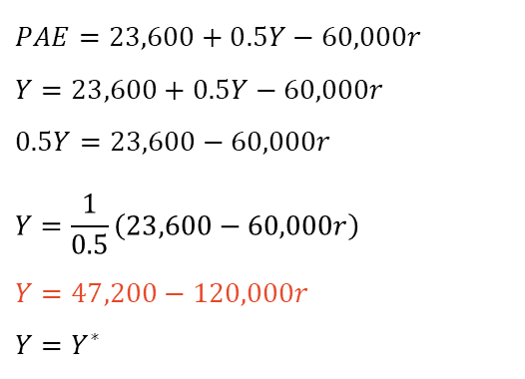
Question 4
An economy is described by the following equations.
b. At what value should the Reserve Bank set the real interest rate to eliminate the output
gap?
$$PAE=23,600+0.5Y−60,000r$$
$$Y=23,600+0.5Y−60,000r$$
$$0.5Y=23,600−60,000r$$
$$Y=\frac{1}{0.5}\left(23,600−60,000r\right)$$
$$Y=47,200−120,000r$$
$$Y=Y^{∗}$$
$$C=14,400+0.5\left(Y−T\right)−40,000r$$
$$I^{P}=8, 000−20,000r$$
$$G=7,000$$
$$X=0$$
$$M=1,800$$
$$T=8,000$$
$$Y^{∗}=40,000$$

Slide 66
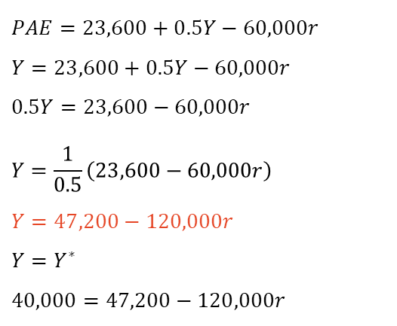
Question 4
An economy is described by the following equations.
b. At what value should the Reserve Bank set the real interest rate to eliminate the output
gap?
$$PAE=23,600+0.5Y−60,000r$$
$$Y=23,600+0.5Y−60,000r$$
$$0.5Y=23,600−60,000r$$
$$Y=\frac{1}{0.5}\left(23,600−60,000r\right)$$
$$Y=47,200−120,000r$$
$$Y=Y^{∗}$$
$$40,000=47,200−120,000r$$
$$C=14,400+0.5\left(Y−T\right)−40,000r$$
$$I^{P}=8, 000−20,000r$$
$$G=7,000$$
$$X=0$$
$$M=1,800$$
$$T=8,000$$
$$Y^{∗}=40,000$$

Slide 67
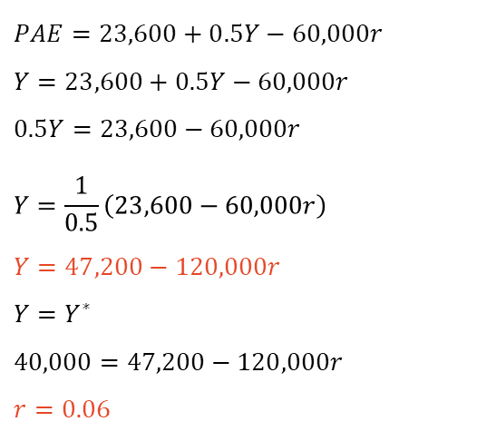
Question 4
An economy is described by the following equations.
b. At what value should the Reserve Bank set the real interest rate to eliminate the output
gap?
$$PAE=23,600+0.5Y−60,000r$$
$$Y=23,600+0.5Y−60,000r$$
$$0.5Y=23,600−60,000r$$
$$Y=\frac{1}{0.5}\left(23,600−60,000r\right)$$
$$Y=47,200−120,000r$$
$$Y=Y^{∗}$$
$$40,000=47,200−120,000r$$
$$r=0.06$$
$$C=14,400+0.5\left(Y−T\right)−40,000r$$
$$I^{P}=8, 000−20,000r$$
$$G=7,000$$
$$X=0$$
$$M=1,800$$
$$T=8,000$$
$$Y^{∗}=40,000$$

Slide 68
Practice Questions

Slide 69
Other things being equal, a negative technology shock (that decreases the marginal product of capital) is most likely to:
Increase the equilibrium level of interest rates and decrease the equilibrium level of saving and investment
Increase the equilibrium level of interest rates, saving and investment.
Decrease the equilibrium level of interest rates, saving and investment
Decrease the equilibrium level of interest rates and increase the equilibrium level of saving and investment.

Slide 70
1. Other things being equal, a negative technology shock (that decreases the marginal product of capital) is most likely to:
Increase the equilibrium level of interest rates and decrease the equilibrium level of saving and investment
Increase the equilibrium level of interest rates, saving and investment.
Decrease the equilibrium level of interest rates, saving and investment
Decrease the equilibrium level of interest rates and increase the equilibrium level of saving and investment.

Slide 71
2. Use the following figure to answer the question:
Increasing government spending by 400
Decreasing government spending by 400.
Increasing government spending by 200
Decreasing government spending by 200

Slide 72
2. Use the following figure to answer the question:
For exogenous taxes and imports in a 4-sector model, for a country with autonomous expenditure 600, the expansionary gap can be eliminated by:
Increasing government spending by 400
Decreasing government spending by 400.
Increasing government spending by 200
Decreasing government spending by 200

Slide 73

3. Han Solo assigned Chewbacca to hire workers for Millennium Falcon from Corellia. In
planet Corellia, the demand for labour and the supply of labour is given by the following
equations.
As a result, the number of workers unemployed on their planet are
$$N_{D}=1200−6W$$
$$N_{S}=600+6W$$
840
960
0.125
120
Here N_D is the number of workers employers want to hire and N_S is the number of workers willing to work. The demand and supply depend on the real wage W, which is measured in
dollars per day. Suppose that the minimum wage on their planet is $60 per day

Slide 74
3. Han Solo assigned Chewbacca to hire workers for Millennium Falcon from Corellia. In
planet Corellia, the demand for labour and the supply of labour is given by the following
equations.
As a result, the number of workers unemployed on their planet are
$$N_{D}=1200−6W$$
$$N_{S}=600+6W$$
840
960
0.125
120
Here N_D is the number of workers employers want to hire and N_S is the number of workers willing to work. The demand and supply depend on the real wage W, which is measured in
dollars per day. Suppose that the minimum wage on their planet is $60 per day

Slide 75
4. Han Solo assigned Chewbacca to hire workers for Millennium Falcon from Corellia. In
planet Corellia, the demand for labour and the supply of labour is given by the following
equations.
If there are 1500 people aged 15 or above living in Corellia at the moment, the labour force
participation rate in Corellia is:
$$N_{D}=1200−6W$$
$$N_{S}=600+6W$$
Here N_D is the number of workers employers want to hire and N_S is the number of workers willing to work. The demand and supply depend on the real wage W, which is measured in
dollars per day. Suppose that the minimum wage on their planet is $60 per day
0.56
0.64
0.88
1.56

Slide 76

4. Han Solo assigned Chewbacca to hire workers for Millennium Falcon from Corellia. In
planet Corellia, the demand for labour and the supply of labour is given by the following
equations.
If there are 1500 people aged 15 or above living in Corellia at the moment, the labour force
participation rate in Corellia is:
$$N_{D}=1200−6W$$
$$N_{S}=600+6W$$
Here N_D is the number of workers employers want to hire and N_S is the number of workers willing to work. The demand and supply depend on the real wage W, which is measured in
dollars per day. Suppose that the minimum wage on their planet is $60 per day
0.56
0.64
0.88
1.56

Slide 77
5. Calculate the unemployment rate and the participation rate for an economy which has the following characteristics:
Working age population: 30 million
Number unemployed: 3 million
Number employed: 12 million
Unemployment rate = 50%; participation rate = 50%
Unemployment rate = 20%; participation rate = 50%
Unemployment rate = 10%; participation rate = 50%
Unemployment rate = 20%; participation rate = 40%

Slide 78
5. Calculate the unemployment rate and the participation rate for an economy which has the following characteristics:
Working age population: 30 million
Number unemployed: 3 million
Number employed: 12 million
Unemployment rate = 50%; participation rate = 50%
Unemployment rate = 20%; participation rate = 50%
Unemployment rate = 10%; participation rate = 50%
Unemployment rate = 20%; participation rate = 40%

Slide 79
6. Suppose that the total expenditures for a typical household in 2000 equaled $2500 per month, while the cost of purchasing exactly the same items in 2003 was $3000. If 2000 is the base year, the CPI for 2003 equals:
0.83
1
1.2
1.25

Slide 80
6. Suppose that the total expenditures for a typical household in 2000 equaled $2500 per month, while the cost of purchasing exactly the same items in 2003 was $3000. If 2000 is the base year, the CPI for 2003 equals:
0.83
1
1.2
1.25

Slide 81
7. Other things being equal, a decrease in the size of the government’s budget deficit is most likely to:
Increase the equilibrium level of interest rates and decrease the equilibrium level of saving and investment.
Increase the equilibrium level of interest rates, saving and investment.
Decrease the equilibrium level of interest rates and increase the equilibrium level of saving and investment
Decrease the equilibrium level of interest rates, saving and investment

Slide 82
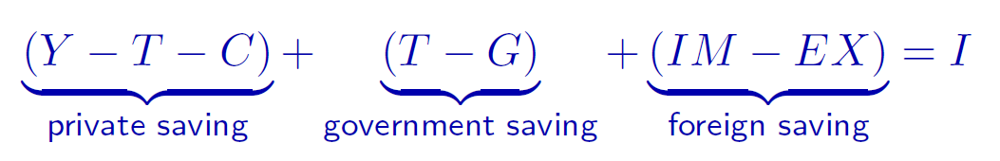
7. Other things being equal, a decrease in the size of the government’s budget deficit is most likely to:
Increase the equilibrium level of interest rates and decrease the equilibrium level of saving and investment.
Increase the equilibrium level of interest rates, saving and investment.
Decrease the equilibrium level of interest rates and increase the equilibrium level of saving and investment
Decrease the equilibrium level of interest rates, saving and investment

Slide 83
8. A hypothetical economy has an official unemployment rate of 4% including a frictional
unemployment rate of 2% and a structural unemployment rate of 3%. This economy is currently experiencing:
A recession
Full employment
An expansionary output gap
A contractionary output gap

Slide 84
8. A hypothetical economy has an official unemployment rate of 4% including a frictional
unemployment rate of 2% and a structural unemployment rate of 3%. This economy is currently experiencing:
A recession
Full employment
An expansionary output gap
A contractionary output gap

Slide 85
Questions?

